Slide 1


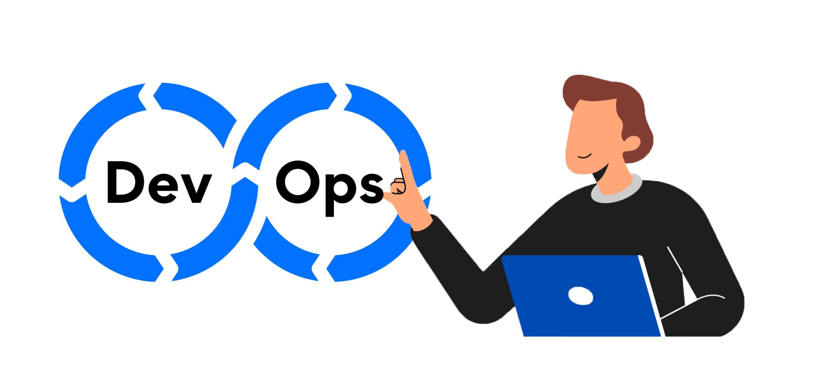

Slide 2
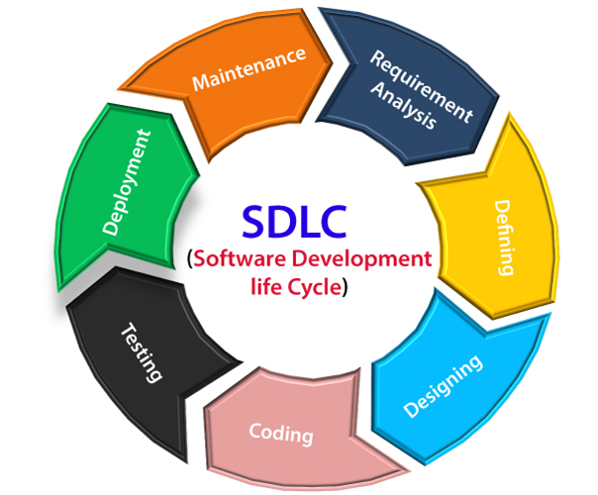
Software Development Lifecycle(SDLC)

Slide 3
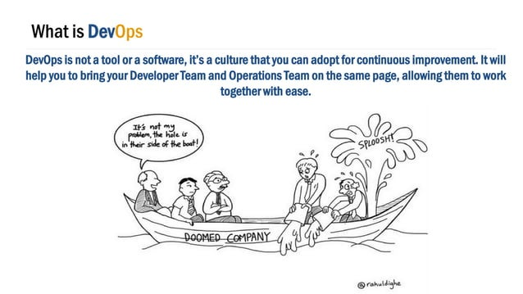

Slide 4
Benefits of DevOps
Faster, better product delivery.
Faster issue resolution and reduced complexity.
Greater scalability and availability.
More stable operating environments.
Better resource utilization.
Greater automation.
Greater visibility into system outcomes.
Greater innovation.

Slide 5
Cornerstone principles-CALM framework
1.Culture-Shared understanding between dev and ops team and sharing the responsibility of the software they build.
2.Automation-The jobs are automation
3.Lean-cutoff which are not necessary
Measurement-make sure that you have the data for backup

Slide 6
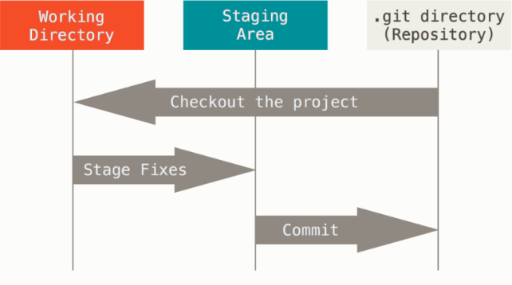

Slide 7
